Slide 1
Mottled Stars - Methodology
How Does Starspot Coverage Affect Stellar Brightness Variability?
Miles L. Johnson

Slide 2
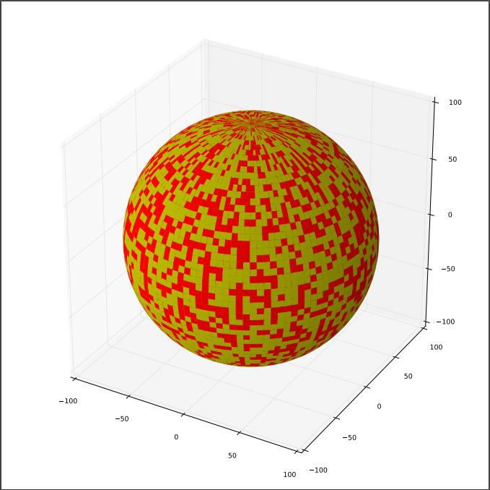
Building 3D Stellar Models
We took a practical approach to the construction of our stellar models
This started with creating a three-dimensional model sphere in our preferred programming language
The surface of the stellar model needed to be tessellated with many small rectangular cells
Code needed to be written that randomly selected cells to be ‘spot cells’ at any given surface coverage

Slide 3
Three-dimensional Model to two-dimensional projection

Slide 4
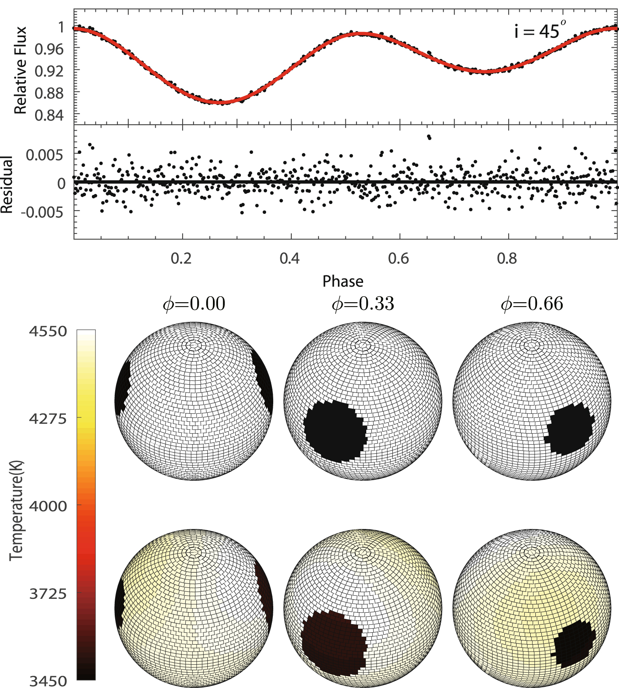
Brightness Integration
Image Credit:

